Slide 1
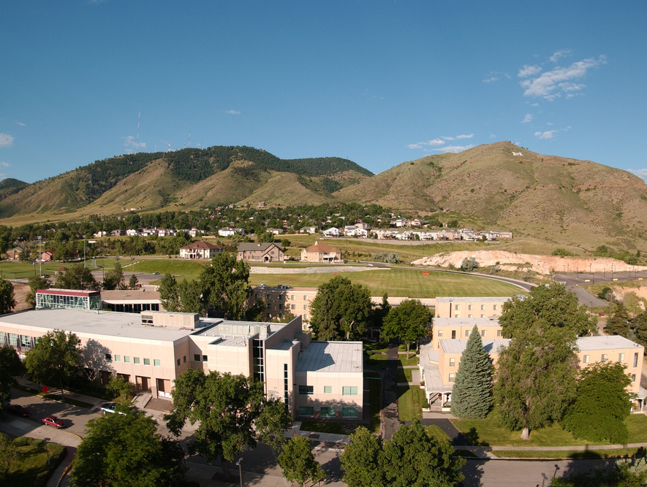
Colorado School of Mines
Computer Vision
Professor William Hoff
Dept of Computer Science
http://inside.mines.edu/~whoff/

Slide 2
SURF - Speeded-Up Robust Features
Bay, Herbert, Tinne Tuytelaars, and Luc Van Gool. "Surf: Speeded up robust features." European conference on computer vision. Springer Berlin Heidelberg, 2006.

Slide 3
SURF
SURF is very similar to SIFT:
It has a detector that tries to detect blob-like features at different scales (these are called “keypoints”)
It computes a feature descriptor at the detected keypoints (these are called “descriptors”)
SURF and SIFT are pretty interchangeable
OpenCV has both implementations
However, SURF is faster than SIFT by a factor of 3, and has recall precision as good as SIFT

Slide 4
SURF
SURF speedup is mainly due to the use of block summing operations, rather than convolutions
Recall what a convolution is:
A sum of products with the filter mask and the image, at each pixel
For large filter masks, this is pretty expensive
SURF uses block summations instead of convolutions
Is implemented very efficiently using “integral images”

Slide 5
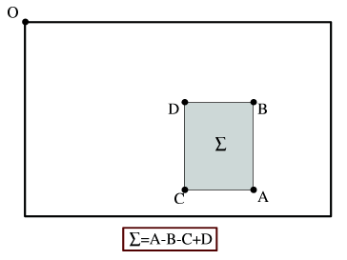

Integral Images
See section 3.2.3 in the Szeliski book
To create an integral image, do one pass over the image
Each pixel stores the sum of the values above and to the left
Once you have an integral image, you can calculate a block sum of any size using only 3 additions: Sum = A-B-C+D
Calculation time independent of size
Integral images

Slide 6
Integral Image - Example
Say that you need to calculate the sum of values in the block, bounded by these four points

Slide 7
Integral Image - Example
A is the sum of all values above and to the left of the lower right point
A

Slide 8
Integral Image - Example
B is the sum of all values above and to the left of the upper right point
B

Slide 9
Integral Image - Example
A-B is the sum of values in the shaded area
A-B

Slide 10
Integral Image - Example
C is the sum of all values above and to the left of the lower left point
C

Slide 11
Integral Image - Example
A-B-C is the sum of the orange block, minus the green block
-B
-C
A

Slide 12
Integral Image - Example
D is the sum of all values above and to the left of the upper left point
Add D back in, to restore the values that we subtracted twice
+D
-B
A-B-C+D is the answer
-C
A

Slide 13
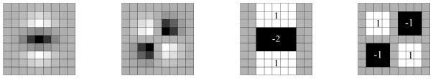


SURF
SURF approximates Gaussian 2nd Derivatives using box filters
Box filters provide speed improvements far outweighing small performance decrease
Filter size does not affect computational cost
2nd derivatives of Gaussian
Equivalent Box Filters
$$\frac{∂^{2}g(x,y)}{∂y^{2}}$$
$$\frac{∂^{2}g}{∂x^{2}}−\frac{∂^{2}g}{∂y^{2}}$$

Slide 14
SURF Keypoints
SURF computes the Hessian matrix at each point
The Hessian is a matrix of second order partial derivatives
Keypoints are points where the Hessian determinant is large
Corresponds to regions that are distinctive in two orthogonal directions (blobs!)
Notes:
Note:
We want larger curvature indicating smaller r.

Slide 15
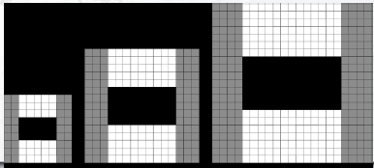
Scale Invariance
Instead of a pyramid of images, SURF uses a series of filter sizes

Slide 16

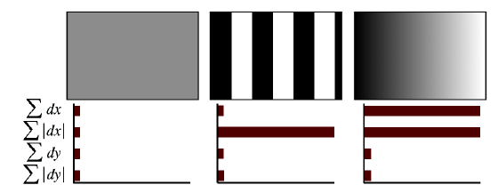
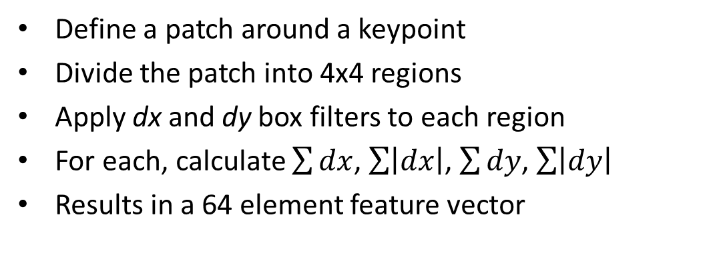
SURF Descriptor
Define a patch around a keypoint
Divide the patch into 4x4 regions
Apply dx and dy box filters to each region
For each, calculate $\sum{dx}$, $\sum{\left|dx\right|}$, $\sum{dy}$, $\sum{\left|dy\right|}$
Results in a 64 element feature vector
dx
dy
Example regions

Slide 17
OpenCV SURF functions
Create the detector
Detect keypoints and compute descriptors
Draw detected keypoints
Unfortunately SURF is patented like SIFT, so you need to use an older version of OpenCV
detector = cv2.xfeatures2d.SURF_create( hessianThreshold=100, # default = 100 nOctaves=4, # default = 4 nOctaveLayers=3, # default = 3 extended=False, # default = False upright=False # default = False )
kp1, desc1 = detector.detectAndCompute(gray_image, mask=None)
# Possible flags: DRAW_MATCHES_FLAGS_DRAW_RICH_KEYPOINTS, DRAW_MATCHES_FLAGS_DEFAULT bgr_display = bgr_img1.copy() cv2.drawKeypoints(image=bgr_display, keypoints=kp1, outImage=bgr_display, flags=cv2.DRAW_MATCHES_FLAGS_DRAW_RICH_KEYPOINTS)

Slide 18
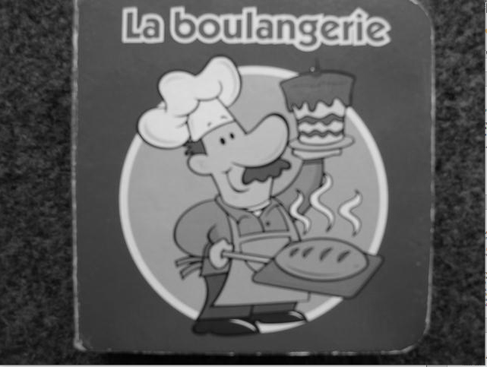
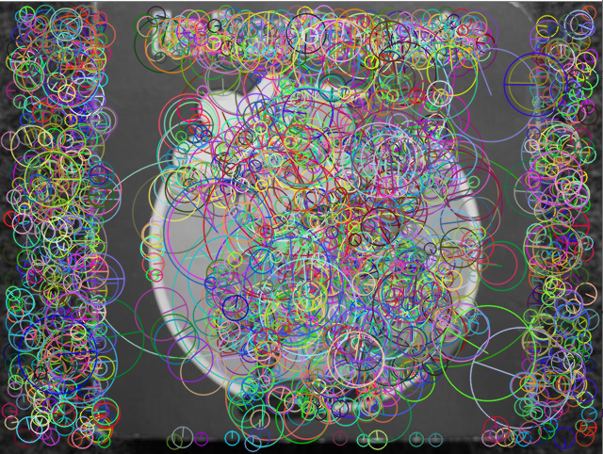
Example
Number of keypoints: 1838
cv2.DRAW_MATCHES_FLAGS_DRAW_RICH_KEYPOINTS

Slide 19
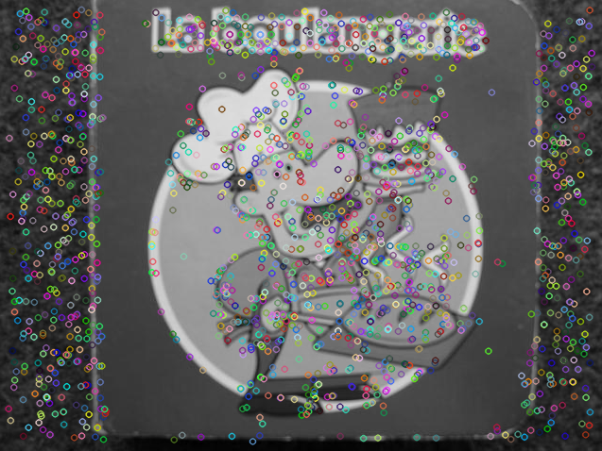
Example – show simplified keypoints
Number of keypoints: 1838
cv2.DRAW_MATCHES_FLAGS_DEFAULT

